Slide 1

ACS314
MOBILE APPLICATION DEVELOPMENT
LESSON 1
MR ANTHONY WAMBUA
awambua@daystar.ac.ke
+254721589325

Slide 2
Reflection
^{Colossians 2:6-7}
⁶ So then, just as you received Christ Jesus as Lord, continue to live your lives in him, ⁷ rooted and built up in him, strengthened in the faith as you were taught, and overflowing with thankfulness.

Slide 3

Introduction & setting up the Android Studio
Overview of Flutter framework
Overview of Dart
Mobile platforms
Compare Flutter to other frameworks

Slide 4

Overview of Flutter framework
Flutter is an open-source UI framework by Google for building beautiful, natively compiled, multi-platform applications from a single codebase.
Released in 2018
Uses the Google graphics library
known as Skia.
Used to develop apps for Android, iOS, Fuchsia , Web, and Desktop (MacOS, Linux, Windows)
What?!

Slide 5
Some History in Mobile Application Development
There are three major mobile platforms:
  Android( Java or Kotlin)
  IOS (Language: Objective-C and Swift)
  Windows Mobile
  Symbian
  PalmOS
A company e.g bank (KCB, Coop Bank), e-commerce (think Jumia) wishing to launch a mobile app had to develop NATIVE apps for each platform separately!!
Used in the early days of mobile apps

Slide 6
Native mobile apps
Developing an app using right tools specific to a certain mobile operating system (OS)
Features:
• Easy access to device APIs such as camera, microphone, location, and so on. • Capability to observe and react to system events • Ability to run background tasks and push notiﬁcations • GPU access for rendering
L1Q1: What are the challenges of having to create native apps for each platform?

Slide 7
Native App Development Benefits
Maximum capability. Native applications can fully use the platform’s capabilities.
Complexity. Native development allows for the creation of complex and performant mobile applications that can be customized and personalized in accordance with the user’s requirements.
Performance. One of the strongest benefits of native components is supreme performance. Engineers can use numerous native app development tools, APIs, and kits that ease the process of building an intuitive and performant product.
Hardware access. Native apps can ask for direct access to the smartphone’s hardware such as a microphone, camera, GPS, etc. Unlike native apps, hybrid and cross-platform apps should use APIs to get access to the hardware, which complicates the app’s performance.
Fewer chances of bugs. Native development reduces the likability of bugs to a minimum. That’s because mobile app developers need to manage one codebase instead of several.

Slide 8
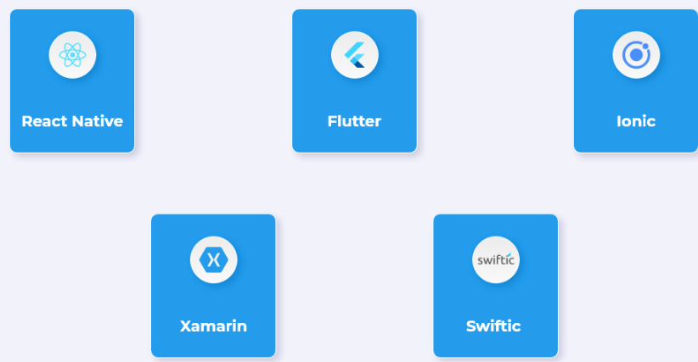
These problems led to the emergence of hybrid frameworks such as
React Native: Very popular. Popularized by Facebook
Flutter: Fastest growth, by Google
Ionic: Free and open-source framework. Developed by MIT
PhoneGap: Developed by Adobe
Xamarin:Owned by Microsoft, Xamarin first came to use in May 2011
Swiftic: DIY app creation platform
L1Q2: What other hybrid frameworks do you know besides the above?

Slide 9
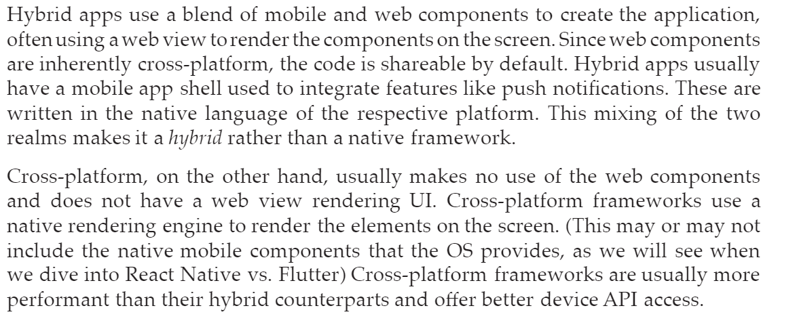
Hybrid vs. cross-platform
The central theme connecting hybrid and cross-platform app development frameworks is code shareability/single codebase , they achieve this in a totally different way!
Further reading here

Slide 10
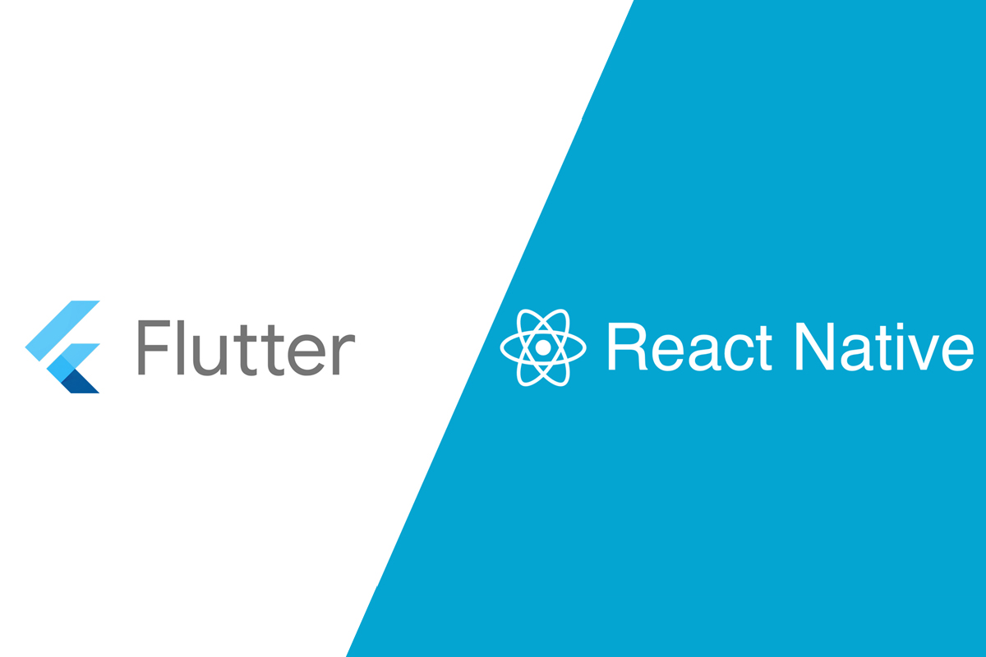
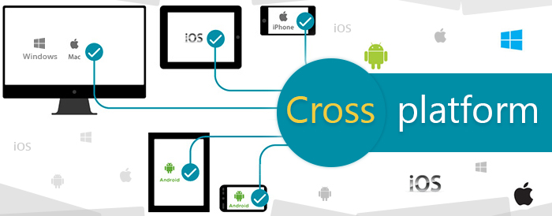
Truly Cross Platform:
Facebook React Native and Google Flutter.
L1Q3: Compare React Native to Flutter highlighting advantages and limitations of each

Slide 11
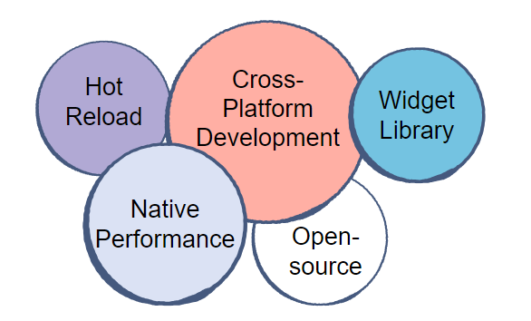
Features of Flutter Framework
Hot reload
Cross-platform development
Widget library
Native performance
Open-source

Slide 12
Hot reload makes it possible to see the changes in the code instantly reflected on the UI. Speeding correction of errors.
Cross-platform development single codebase for Android, IoS Web, Mac and Windows
Widget library everything in flutter is a widget!! Cupertino pack and Material Design are inbuilt. We can create very complex widgets
Native Performance utilize native features such as camera and geolocation giving the same performance as native apps.
Open-source thus a community of Flutter enthusiasts who come together to answer questions related to Flutter and discuss it. Flutter is free of cost and has detailed documentation and communities available online

Slide 13
Another Language??! Why
Why not Java, Kotlin etc??
Dart was chosen for a very speciﬁc feature set that gives Flutter an edge over existing languages
1.Easier to learn: Dart does not require an exorbitant time required to learn.
Developers can focus on the Flutter framework instead of spending time adapting their existing knowledge to ﬁt the new language and semantic constraints.

Slide 14
2. Can be Ahead-Of-Time (AOT) or Just-In Time (JIT) compiled according to need: AOT compilation eliminates the need for code to be compiled every time it is run, leading to faster startup times. This is eﬀective when apps are installed on a user’s device, leading to much quicker app launches.
AOT, however, leads to slower development times when the code is changed or updated. This is when JIT compilation makes for a pleasant development experience oﬀering easy and quick code changes. Dart uses JITin development and AOT in production apps, the best of both worlds.
The JIT technique allows for the stateful hot reload Flutter is famous for.

Slide 15
3.Eliminates the need for a declarative language similar
to XML (Android)or JSX (React):
Declarative layout languages often add a lot of code to the application by deﬁning a separate language for UI and code. For example, in Android.

Slide 16
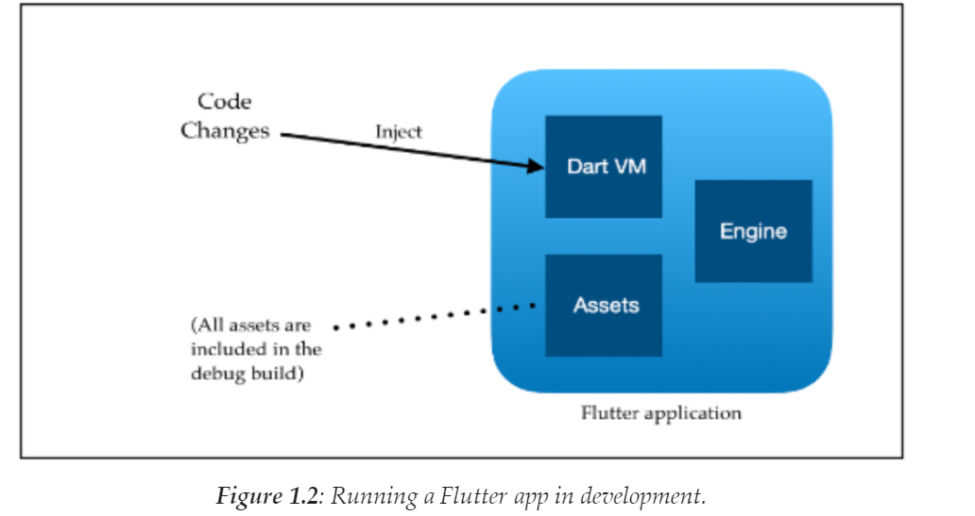
We will learn about Dart in the next lesson

Slide 17
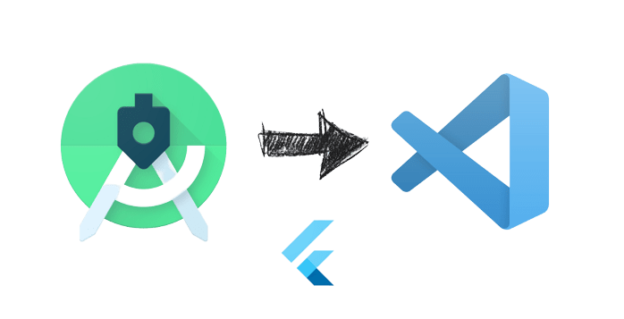
IDEs for Flutter Development
Android Studio by Google (based on InteliJ IDEA)
VSCode by Microsoft.
Intelij IDEA

Slide 18
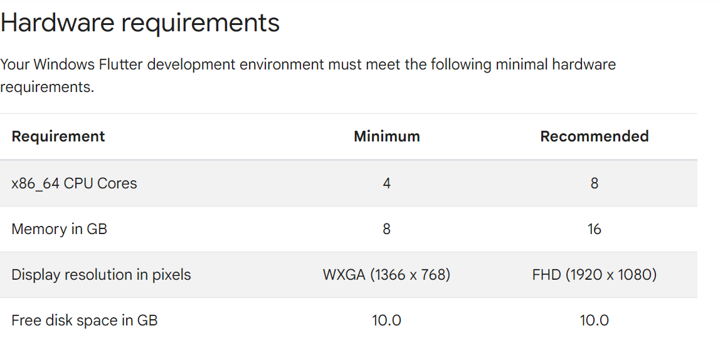
Setting up

Slide 19
Testing Applications
It is recommended that you have a physical Android Phone & USB cable.
OR
Create an emulator device works well with 16GB RAM and SSD

Slide 20
IDE (Android Studio, VS Code )
Download flutter sdk
  Install dart and flutter plugin (This for both Android Studio and VSCode)
  Run the default application using an emulator or Physical device

